Slide 1

SELLING AUTOMOBILES APPLICATION
Supervisor : Mrs. G. Meera Gandhi
Name of the Student : Srivarsh Sakthivelan
Register Number: 391110973

Slide 2
PRESENTATION OUTLINE
Course Certificate
Abstract
Introduction
Objectives
Requirements
Work Flow Diagram
Module Implementation
Results & Discussions
Conclusion
References

Slide 3
COURSE CERTIFICATION

Slide 4
ABSTRACT
Automotive industry in India is one of the main pillars of the Indian economy. Its a crucial factor to our GDP and helps us understand how our nation is doing financially.
One of the areas in which this project observes is the used car industry. The sales of used cars are most often directly proportional to the sale of new cars.
The COVID-19 pandemic has surprisingly had a minimal impact on the used car industry (against our predictions).
With the increased number of people preferring individual mobility options infused into the used car market, the market is set to grow considerably.
The system has been developed using HTML & CSS to make an user friendly website.

Slide 5
INTRODUCTION
The Hyper Text Markup Language or HTML is the standard markup language for documents designed to be displayed in a web browser.
It can be assisted by technologies such as Cascading Style Sheets and scripting languages such as JavaScript.
Here I will be using these tools to make an application for the sale of used cars.
Vehicle pictures along with all the known attributes as well as price will be displayed.
The purpose of this project is to show how these web development tools can be used for business purposes such as making an application where one can sell used cars .

Slide 6
OBJECTIVES
The primary objective of this project is to create a viable website that can be used for the sale of used vehicles.
Prospective customers can view vehicles from the available palette of the lot that the dealer possesses.
This project will use Microsoft Visual Studio as the project environment.
Other information regarding the company of the used car sales company will also be provided in the consequent pages/GUI screens.
Seamless representation on the information about the vehicles, about us, frequently asked questions, etc.

Slide 7
REQUIREMENTS
HARDWARE REQUIREMENTS
Graphics Processing Unit
Any Operating System
SOFTWARE REQUIREMENTS
Microsoft Visual Studio- Project environment
Any Web Browser (preferably chrome)

Slide 8
WORK-FLOW DIAGRAM
Customer
Admin
Home Page
About Us
Testimonials
FAQ
Inventory

Slide 9
MODULE IMPLEMANTATION
HTML - (the Hypertext Markup Language) for building the structure of the page.
CSS - (Cascading Style Sheets) technology for building the (visual and aural) layout, for a variety of devices.
JavaScript - It is a lightweight, interpreted, object-oriented language with first-class functions, and is best known as the scripting language for Web pages.
Microsoft Visual Studio – It is an integrated development environment used to develop computer programs, as well as websites, web apps, web services, etc.
Prettier is an opinionated code formatter. It enforces a consistent style by parsing your code and re-printing it with its own rules that take the maximum line length into account, wrapping code when necessary.

Slide 10
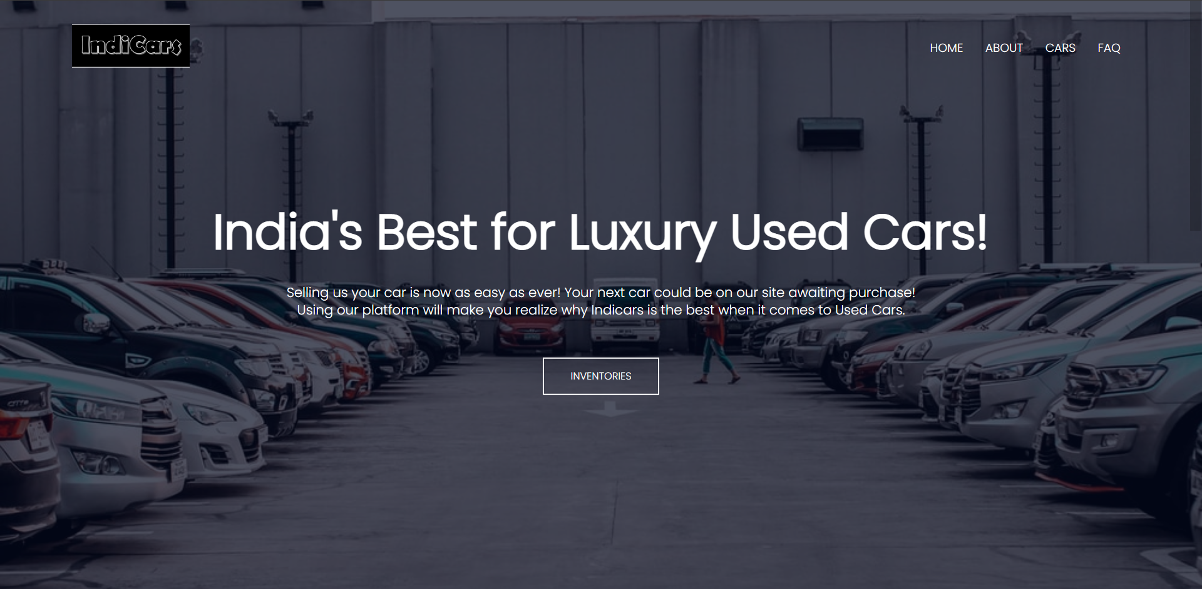
RESULTS
Homepage for the used luxury car dealer “INDICARS”.

Slide 11
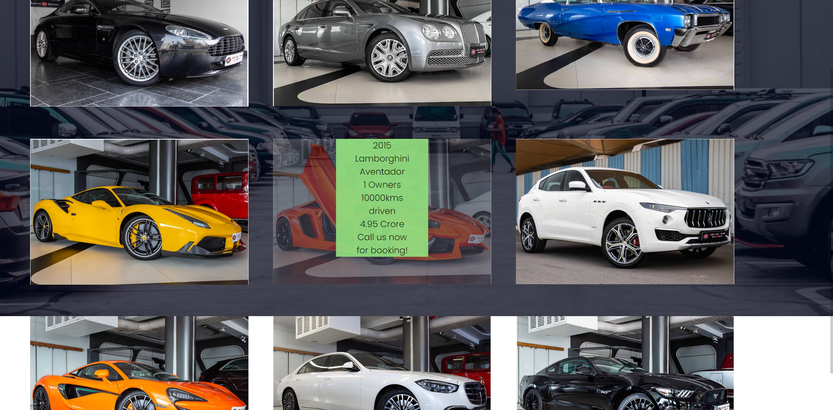
RESULTS
Inventory page for the used luxury car dealer “INDICARS”.

Slide 12
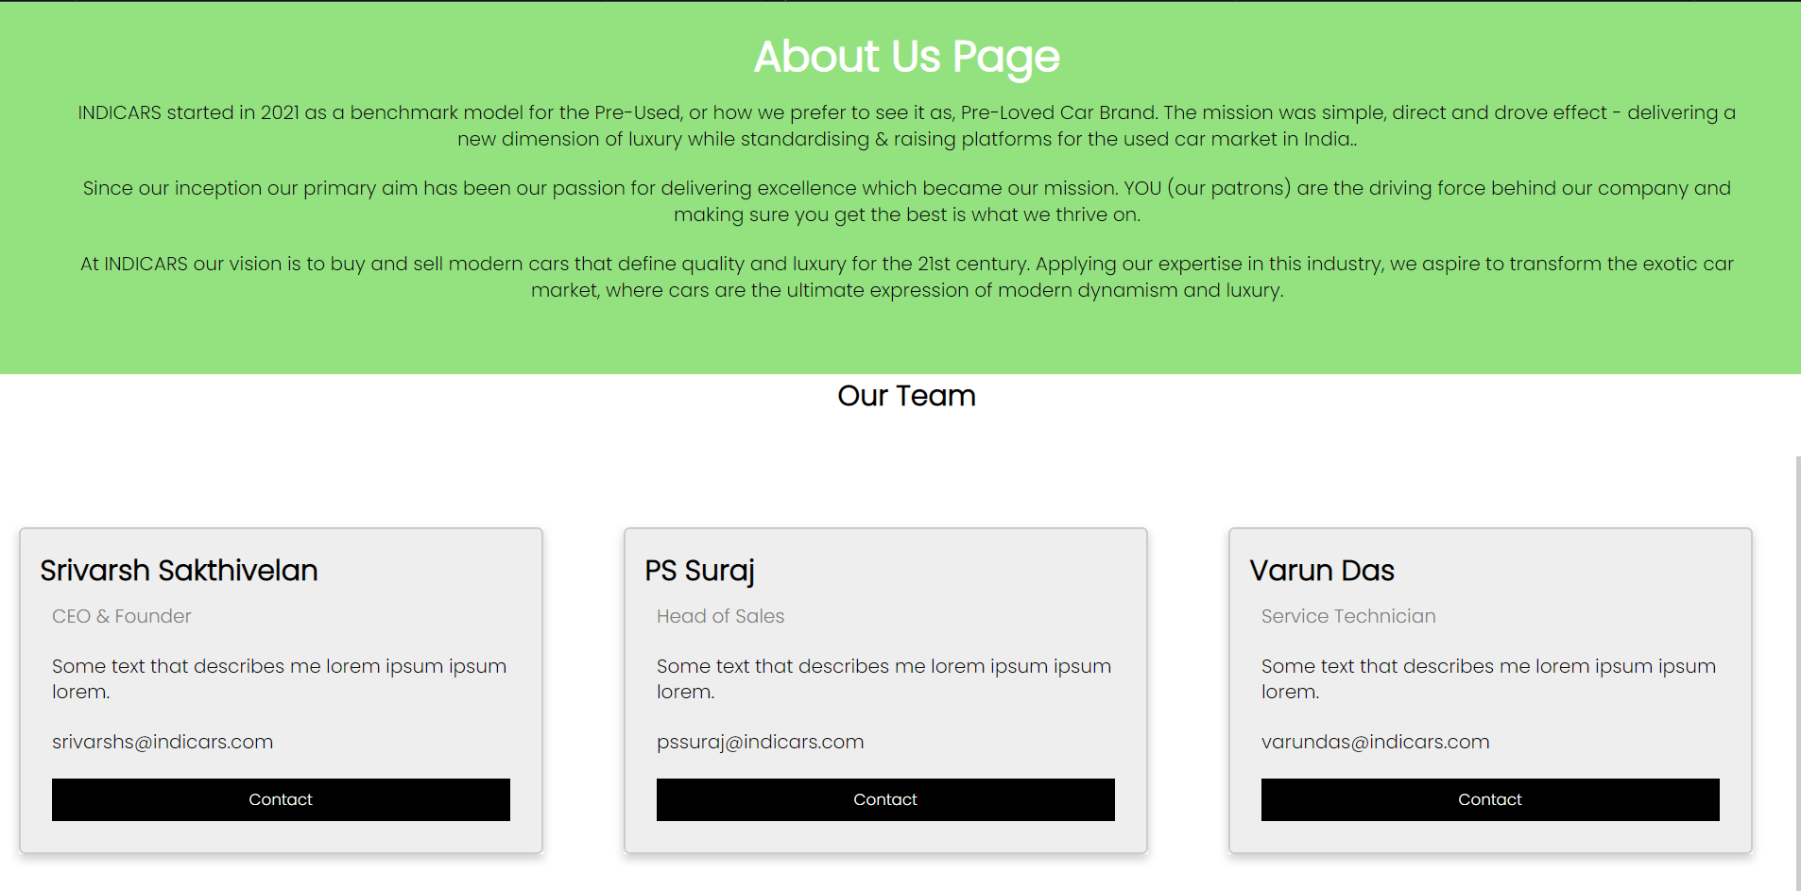
RESULTS
About us page for the used luxury car dealer “INDICARS”.

Slide 13
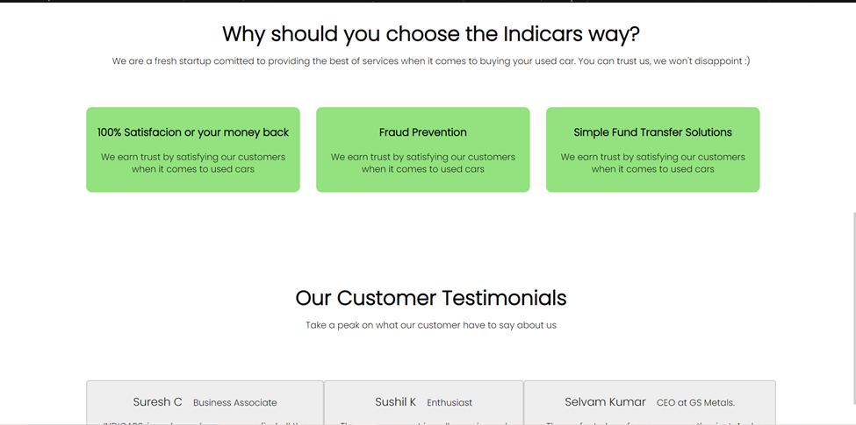
RESULTS

Slide 14
RESULTS
The virtual used luxury car dealership was successfully developed using HTML5, CSS3 and java script technology.
Any consumer/customer can browse vehicles, get some insights about the dealer that is “About us” and “FAQ”.
Each and every vehicle listed on the site includes detailed information such as year, make & model, kms driven, no of owners, etc.
This project has successfully used Microsoft Visual Studio, and Google chrome as the project environment.
The intension of this project is to reduce marketing strain of a luxury dealership to a large extent.

Slide 15
DISCUSSIONS
Simple Layout
User friendly programming language
Seamless interface
Provides a glimpse into the vast applications possible when it comes to HTML, CSS, and JavaScript . This project is just the tip of the iceberg.

Slide 16
CONCLUSIONS & FUTURE FURTHER APPLICATIONS
In the process of research, I came to know about the various html techniques and it’s different uses in helping to create a website.
CSS and webpage design integration .
How information presented can alter/enhance/decrease the customer experience.
The designed application will have an admin view and the public or guest view.
The admin view is meant for the administrator to update the vehicle records, change prices, remove/ add vehicles and also manage the customer base.
The customer view will be available only to the customers, they will be able to handle the information updated by the admin such as their make, model, and booking. Also, the customer will be able to pre-book vehicles by paying the fee issued by the dealer.

Slide 17
REFERENCES
https://www.youtube.com/watch?v=tuURYMcX8S8
https://www.youtube.com/watch?v=ZFQkb26UD1Y
www.OLX.com
www.tutorialspoint.com
https://www.w3schools.com/howto/howto_css_image_overlay.asp
https://www.geeksforgeeks.org/

Slide 18

SELLING AUTOMOBILES APPLICATION

Slide 19


